Slide 1
Infrastructure As Code
by: Zak Salhab

Slide 2
Infrastructure as Code - What, Why, How?
What? Management of Infrastructure via descriptive non-interactive deployment methodologies
Why? To minimize human error, manage risk, gain efficient repeatability, and solve the root cause of environment drift in the release pipeline
How? Declarative push methodology with traditional coding principles of source control and branching with versioning. Bringing the discipline of software development to development of DevOps toolchains

Slide 3
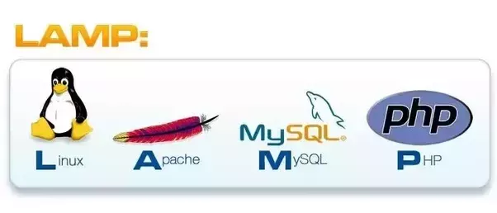
Overview
Technology:
AWS CloudFormation
AWS EC2 Jump box
AWS EC2 LAMP Deployment
AWS S3 Object Storage
GitHub Repository
Bash Scripting
YAML
LAMP Stack

Slide 4
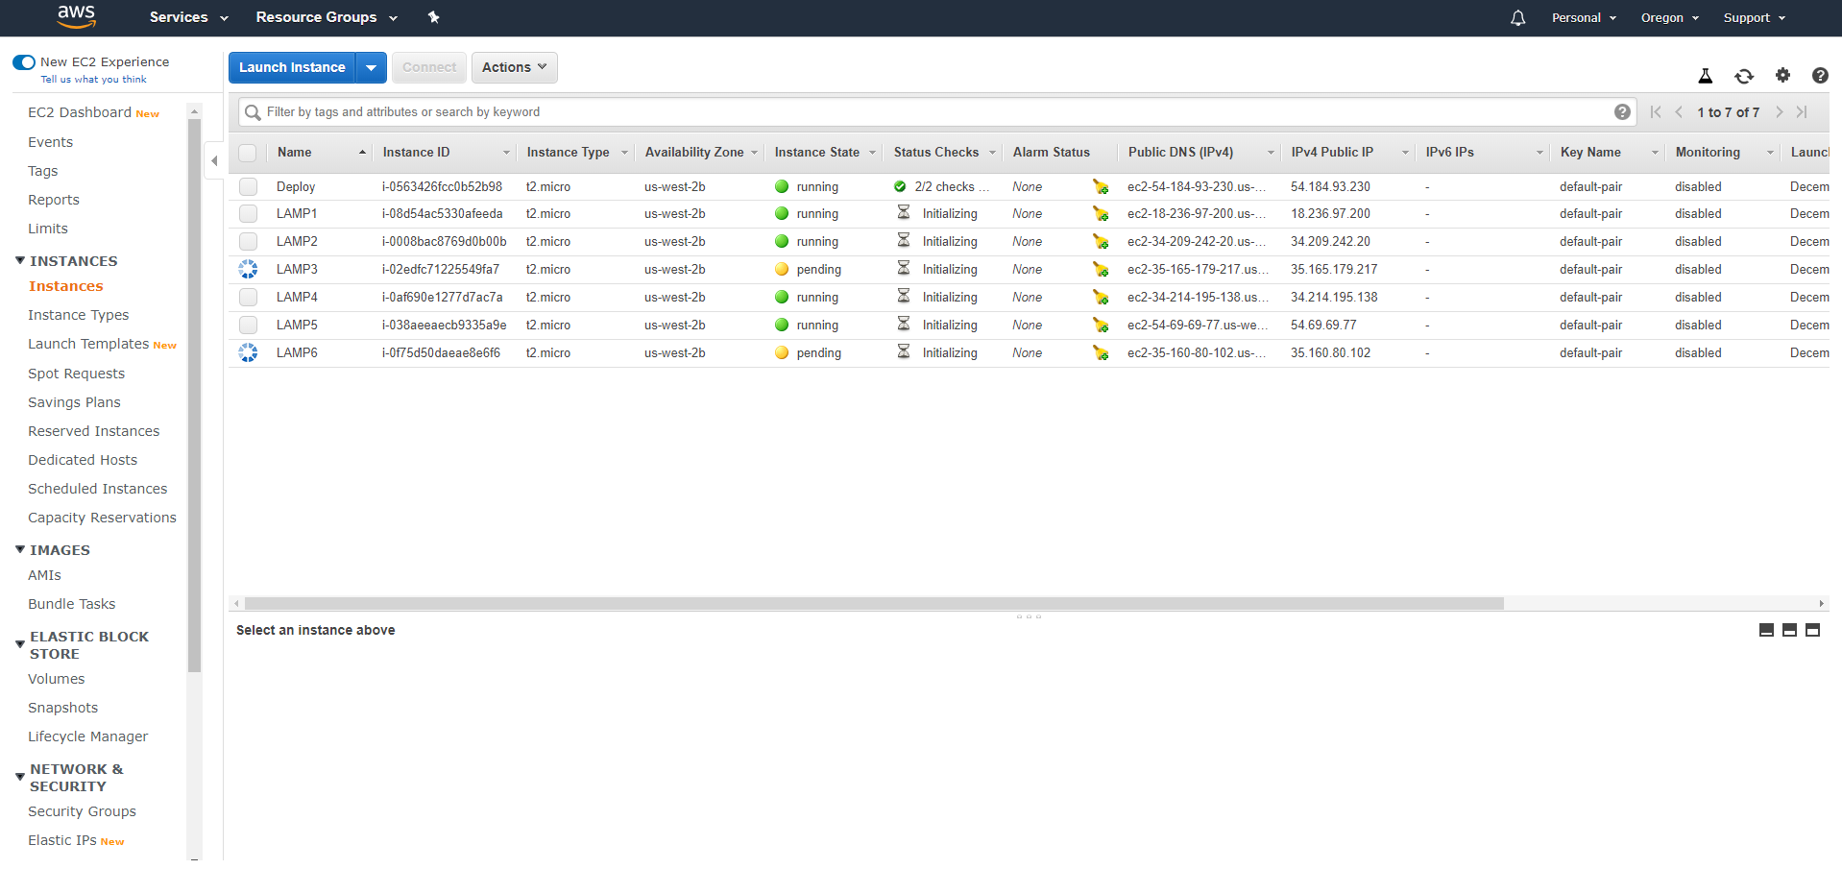
Demonstration

Slide 5
Assumptions and Barriers
Assumptions:
GitHub Integration would have been straight forward and simple
Using a single integrated cloud solution would be the simplest approach
Using a hybrid multi-cloud singular toolchain would be far more difficult
Barriers:
Automated GitHub deployment of source code was difficult and a manual work around was used
Deployment templates available were of the very simplest variety and not multi-tier production ready architectures
Using S3 for file storage doesn’t seem like the most elegant solution for this purpose

Slide 6
Lessons Learned
Toolchain selection is critical for enterprises adopting a hybrid multi-cloud strategy
Environment setup to prepare for configuration was also complex and time consuming (can that be automated?)
Determining the final state configuration is an important first step before automating
Secure code deployment adds another layer of complexity

Slide 7
Next Steps
Configure auto pull or push from GitHub Repository to keep code updated and consistent
Infrastructure agnostic deployment methodology (Terraform?) – multi-cloud hybrid deployment capabilities
Add more infrastructure components to configuration files (Load balancer, resiliency options, VPCs and/or stretch clusters, tiered production ready architectures)
Add elasticity options for burst capacity to the architecture

